Slide 1
Fortiweb automation to FeiShu
LiuGang
2025-07-30

Slide 2
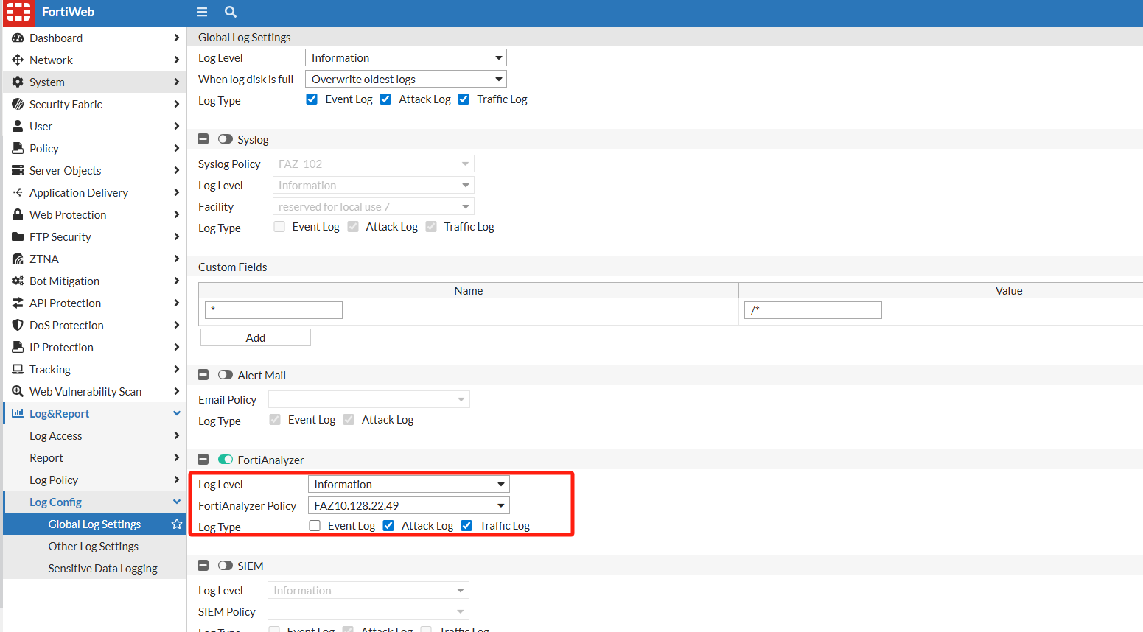
FWB log to Analyzer

Slide 3
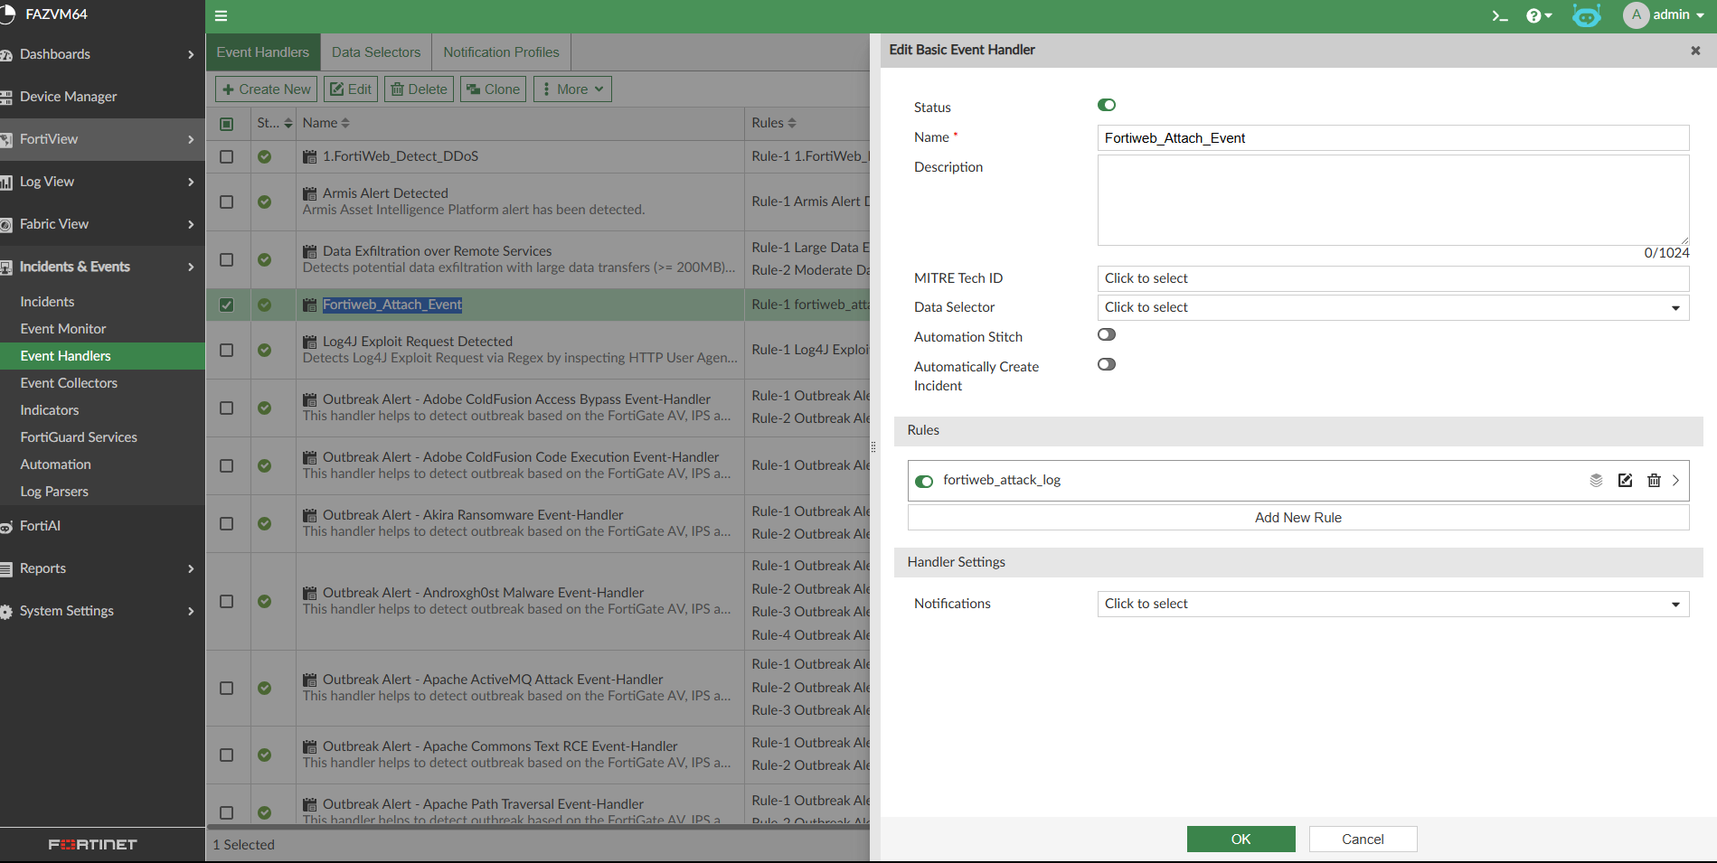
Fortianalyzer Event Handler-1

Slide 4
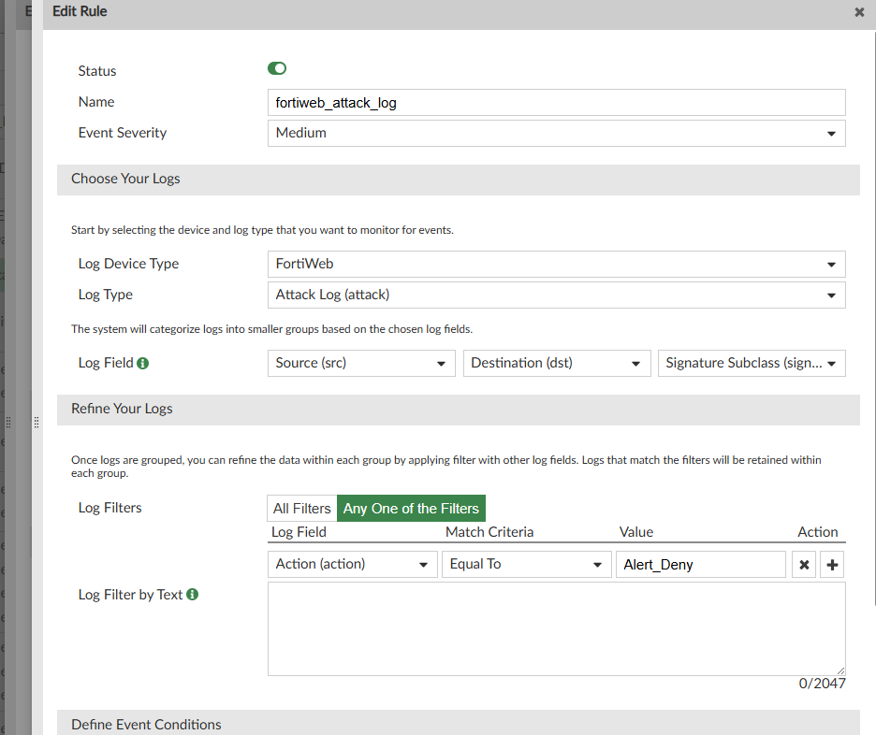
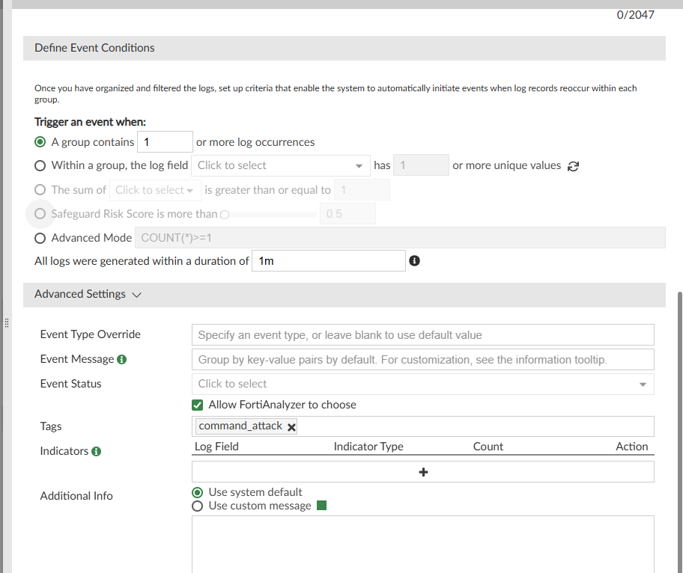
Fortianalyzer Event Handler-2

Slide 5
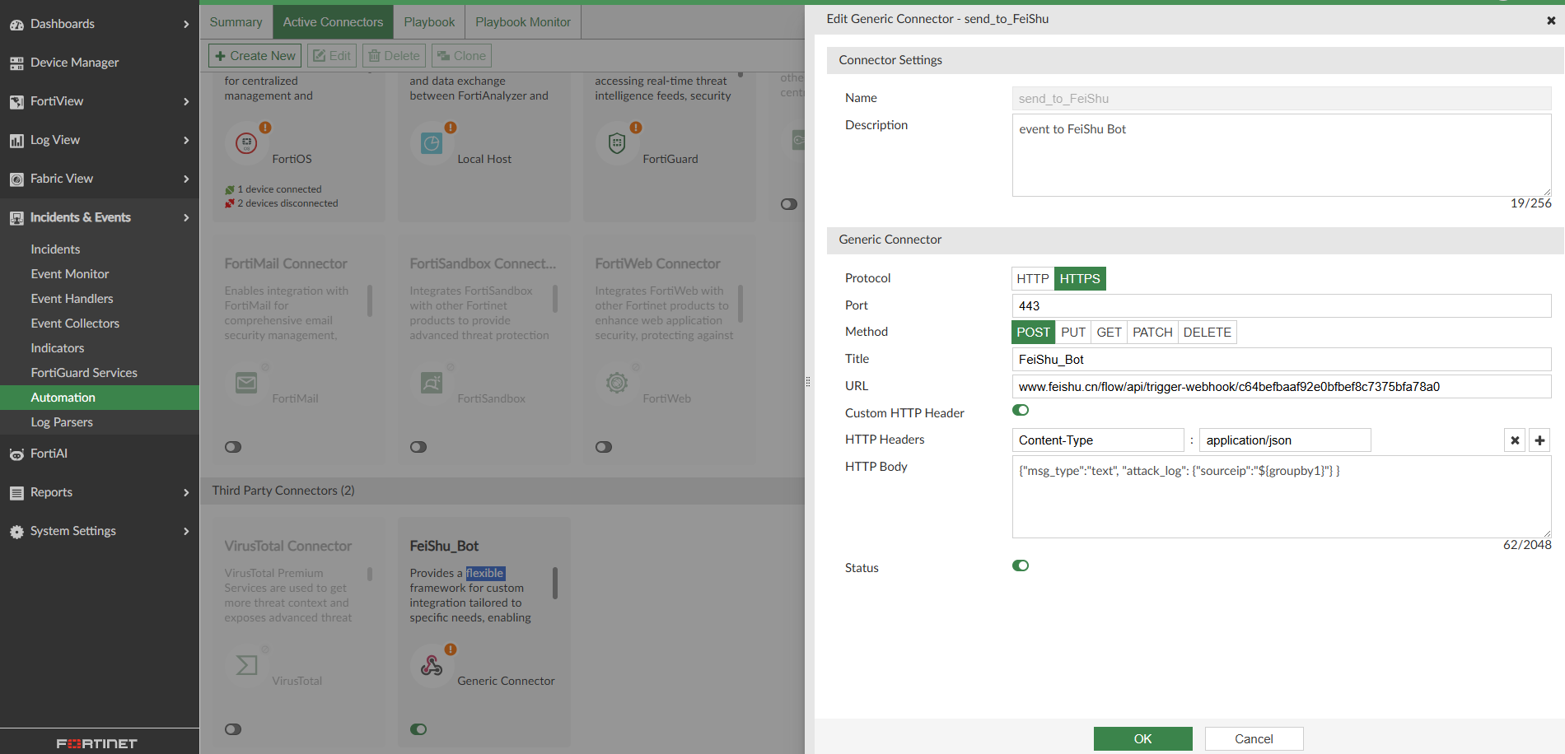
Fortianalyzer Automation Connector

Slide 6
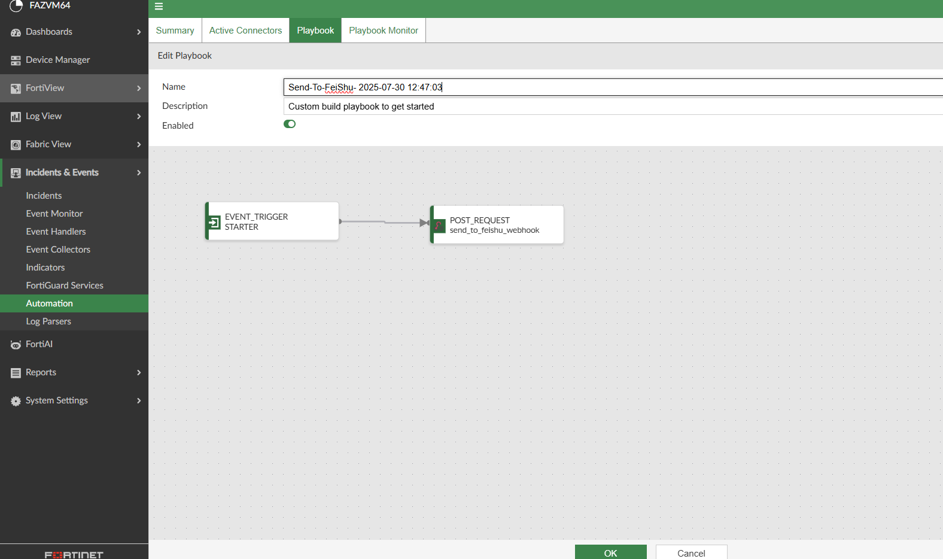
Fortianalyzer Automation Playbook-1

Slide 7
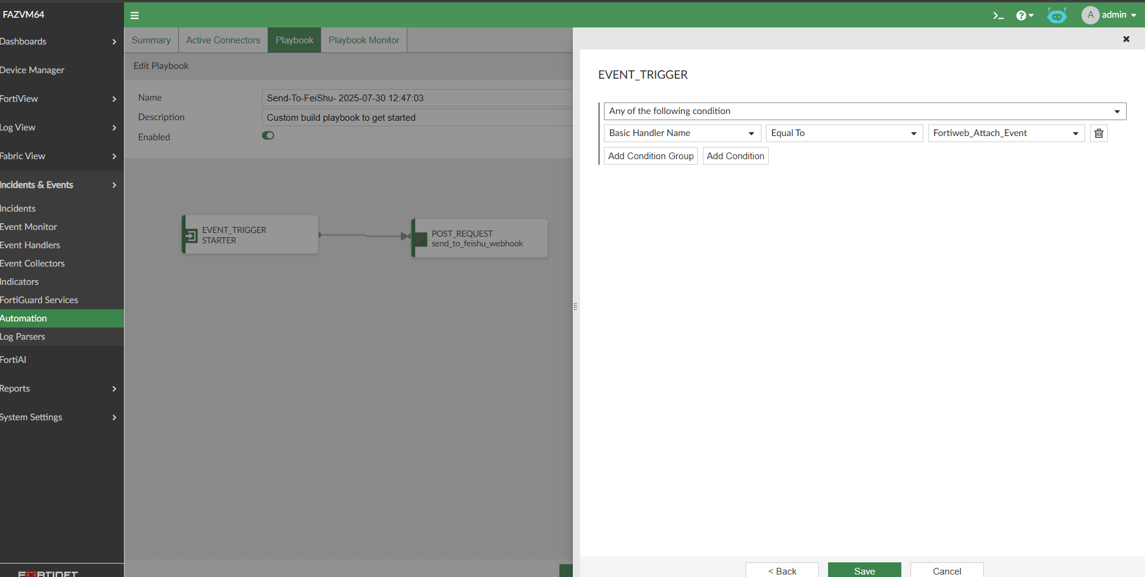
Fortianalyzer Automation Playbook-2

Slide 8
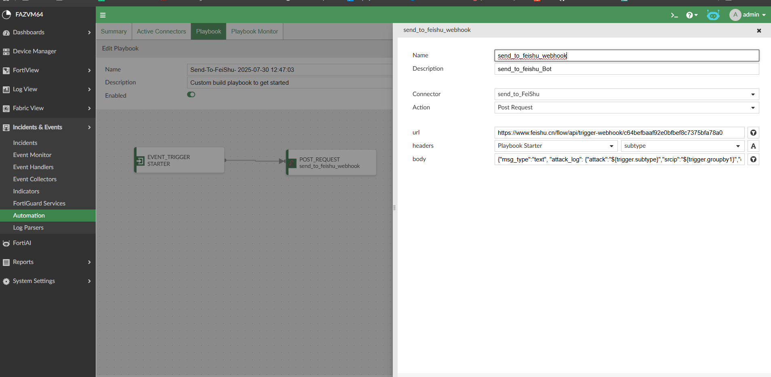
Fortianalyzer Automation Playbook-3
Notes:
{"msg_type":"text", "attack_log": {"attack":"${trigger.subtype}","srcip":"${trigger.groupby1}","dstip":"${trigger.groupby2}","attack_type":"${trigger.groupby3}"} }

Slide 9
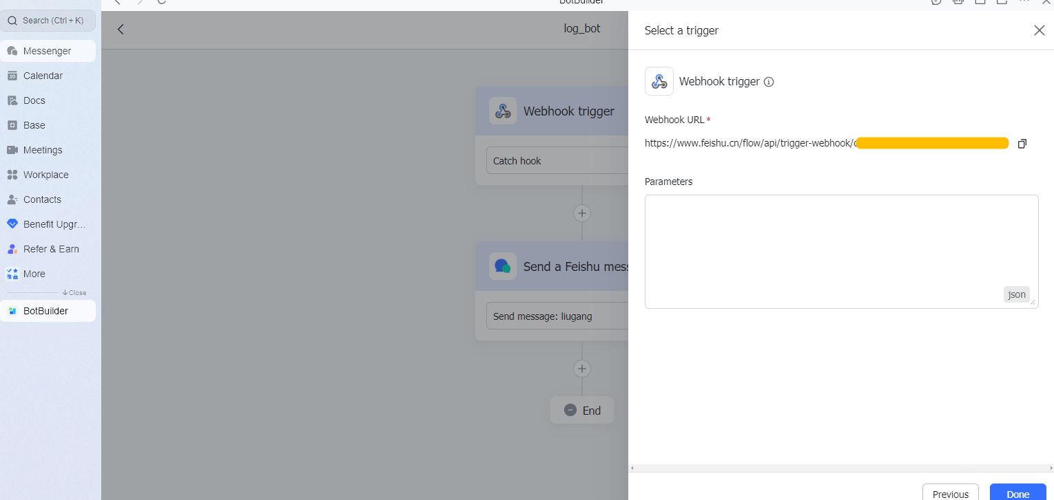
飞书 bot-1

Slide 10
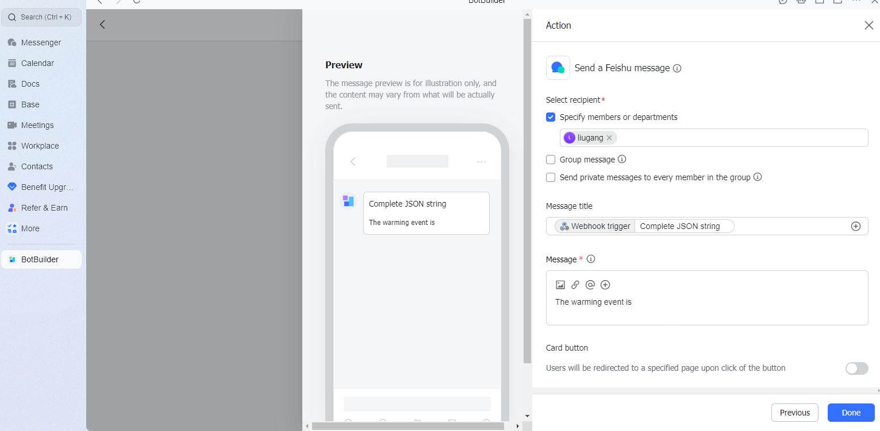
飞书 bot-2

Slide 11
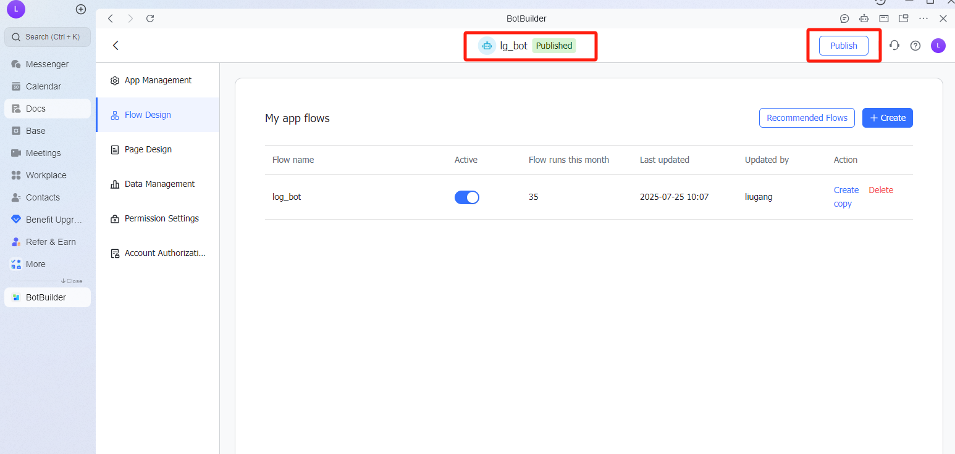
飞书 bot-3

Slide 12
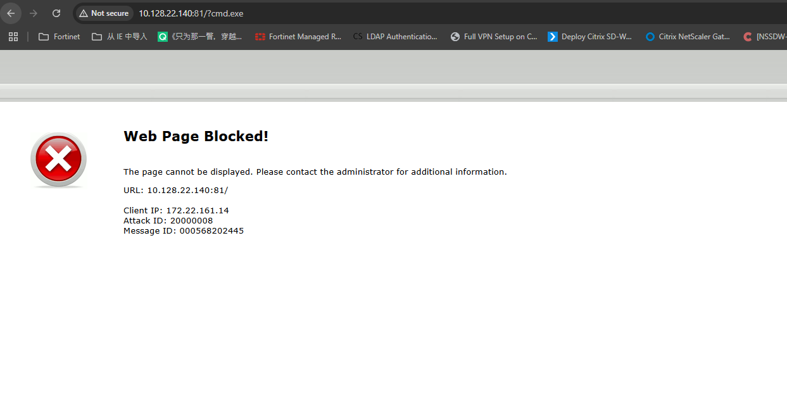
触发攻击

Slide 13
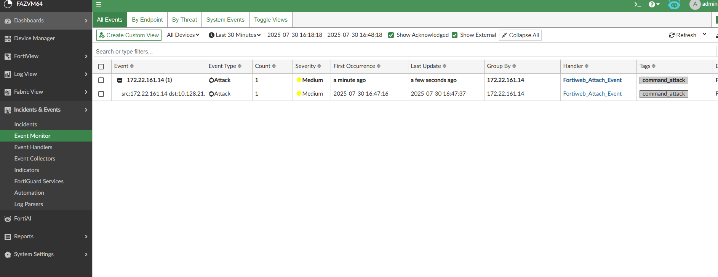
Event monitor

Slide 14
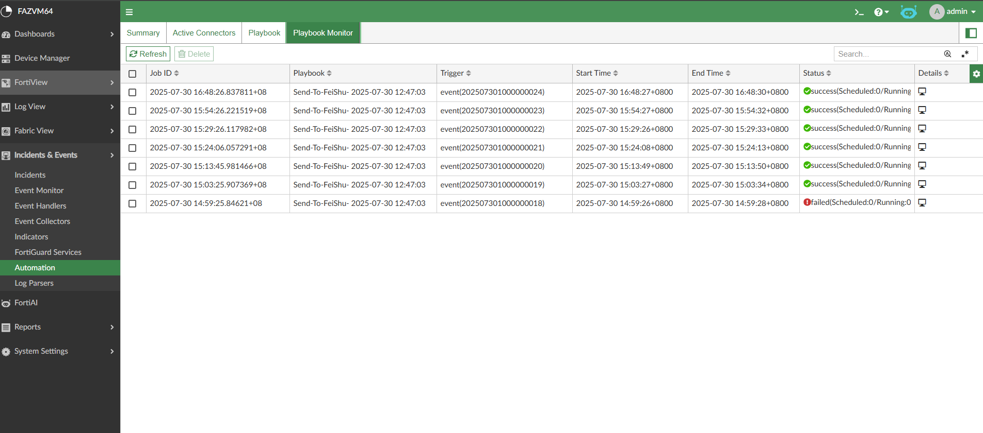
Playbook monitor

Slide 15
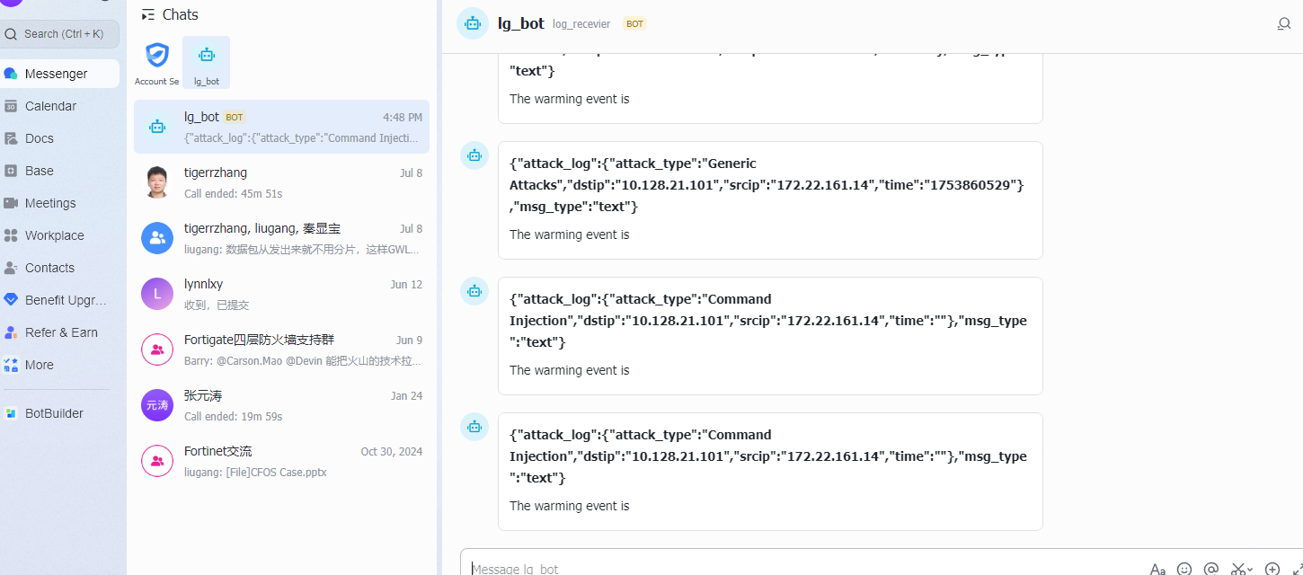
飞书 bot_log

